Slide 1
Claims Data
June 11, 2026
Notes:
Good Morning Everyone. I have a brief overview of claims administration for May 2026 and a Year Over Year claims data comparison for you.

Slide 2
Three Month Claims Filed Trend & Year Over Year Comparison 2025 to 2026
Claims filed as of 5/31/26: 440,071
Mar 26-May 26 Three Month Trend Total: 30,399
Three Month Moving Average: 10,133
Claims Filed increase from Mar-May 25 14.62%
A YTD increase of 5,310 Claims or 12.17%
A Year Over Year May Increase of 10.39%
Notes:
The three-month claims filed trend is 30,399 total claims received with a monthly moving average of 10,133. This is a Year Over Year increase in claims filed of 14.62% compared to the Mar -May 2025 period. May 2026 Year Over Year claim volume is 10.39% higher than 2025.

Slide 3
24-25 to 25-26 YOY Quarterly Claims Filed Comparison
Year Over Year Increase of 11,227 Claims 11.06% Actual Claims Filed
Notes:
Year over year Claims filed shows program growth with an increase of 11,227 claims filed. This represents an 11.06% growth rate in actual claims filed Year Over Year in 25-26 compared to 24-25. These are actual applications filed of which almost all pregnancy cases with bonding time are counted as a single case in the actual case count.

Slide 4
Claims Filed as of 5/31/26 : Cumulative 440,071 June-May 24-25, 113,730 June-May 25-26 124,653
Notes:
Year over year Claims filed shows program growth with an increase of 10,923 claims. This represents an 9.60% growth rate in claims filed Year Over Year in June to May 25-26 compared to June to May of 24-25. The data presented includes 12,247 pregnancy cases with bonding as a 2nd reason for 24-25 and 11,943 pregnancy cases with Bonding as a 2nd reason from 25-26.

Slide 5
Leave Reason by Gender 12 Month Trend June 2025-May 2026
All Leaves Percent by Gender: Female 62.97%, Male 34.21%, Choose not to Answer 2.62%, Non-Binary .19%
Notes:
This slide illustrates 12-month Claims by Leave Reason and percentage of claims filed by Gender statistical trends. The categories represented in the Bar Chart are the four largest leave reasons totaling 99.4% of claims filed. Other leave categories are in the chart on the right and total a little more than one half a percent of total claims filed.
The bonding data presented includes 11,943 cases representing the bonding segment of pregnancy claims filed.

Slide 6
June-May 2025-2026 Actual Claims Filed Plus Bonding as a 2nd Claim Reason
30,538
12.05%
March-Feb 2025-2026 Claims Filed 112,710 - Bonding Segment 11,943 - Total Claims Filed 124,653

Slide 7
Adjudicated Claims Status
Calendar Year Over Year Adjudicated Claims
2024 2025 Change
Approved 73,038 78.04% 75,317 78.61% .57%
Denied 20,553 21.96% 20,500 21.39% .57%
Calendar Year 2025 Adjudication
Including Bonding Segment
2025 Change
Approved 86,950 80.92% 2.88% *
Denied 20,500 19.08% 2.88%
* Cumulative change from Cal YR 2024 Approval/Denial rates
Six Month Claims Adjudication Trend
Actual Including Bonding Segment
Change
Approved 36,434 78.03% 42,035 80.38% 2.35%
Denied 10,261 21.97% 10,261 19.62% 2.35%
As of 5/31/2026
Notes:
Year over year adjudicated claims show a .57% Approval rate increase from 2024 to 2025.
When adding the bonding segment of pregnancy cases, Approved claims rise to almost 87,000 and the approval rate rises an additional 2.31% to 80.92%. The Denial rate drops to 19.08%.
The six-month Dec 25 – May 26 period totaling 36,434 Approvals with an approval rate of 78.03%. When including the bonding segment of pregnancy cases, Approved Claims increase to 42,035 and the Approval rate increases to 80.38%.

Slide 8
Race and Ethnicity Data
Race and Ethnicity Data 8/1/23-5/31/26
Race Statistics | Responses | Percent of Responses | Approved % | Denied %
Response Rate | 34.18%
American Indian or Alaska Native | 763 | 0.77% | 73.87% | 26.13%
Asian | 5,520 | 5.28% | 82.63% | 17.37%
Black or African American | 12,559 | 12.62% | 75.18% | 24.82%
Native Hawaiian or Other Pacific Islander | 214 | 0.22% | 67.50% | 32.50%
White | 69,760 | 70.11% | 82.03% | 17.97%
Prefer not to answer | 8,218 | 8.26% | 78.23% | 21.77%
Other-Multiple Category Responses | 2,530 | 2.74% | 74.23% | 25.77%
Number of Responses | 99,485 | 100.00% | 80.58% | 19.42%
Ethnicity Statistics | Responses | Percent of Responses | Approved % | Denied %
Response Rate | 33.28%
Hispanic or Latino | 18,740 | 19.35% | 77.01% | 22.99%
Not Hispanic or Latino | 72,698 | 75.05% | 81.50% | 18.50%
Prefer not to answer | 5,274 | 5.44% | 80.30% | 19.70%
Other-Multiple Category Response | 149 | 0.16% | 68.93% | 31.07%
Total Number of Responses | 96,871 | 100.00% | 80.56% | 19.44%
Notes:
The Race and Ethnicity data was collected on an opt in basis beginning in August of 2023. The data reported are cumulative statistics from August 2023 through February 2026. The opt in response rate for both Race and Ethnicity has remained consistent at 34% and 33%, respectively. Approval and denial rates are relatively consistent with overall program rates although there are a couple of categories that have lower approval rates. To the extent those differences are not skewed by low response rates, additional outreach efforts by the Community Education Coordinators may help to improve some approval percentages. The outreach efforts being made through the Community Education Coordinators is focused on underserved communities.

Slide 9
52 Week Trend Claim Payments
Minimum wage increases of 4.46% on 1/1/25 and 3.61% on 1/1/26
Notes:
The weekly payments trendline graph shows significant weekly payment growth to an average $9.92 Million Dollars per week over the last 26 weeks and $10.29 Million per week over the last 13 weeks. The trend is being driven by three components. A year over year increase in claims filed of 9.60%, an increase in the approval rate of 2.88% and two increases in weekly benefit rates tied to minimum wage increases. These minimum wage increases compound to an 8.23% increase in weekly benefit rates. Some lower weekly payment data in December 2025 and early January 2026 reflect seasonality in claims filed we have consistently seen over the last four years in leaves filed in November and December. The payment volume variation was more pronounced with fewer business days in the week of Christmas, and the subsequent payment processing catch up the week after New Year.

Slide 10
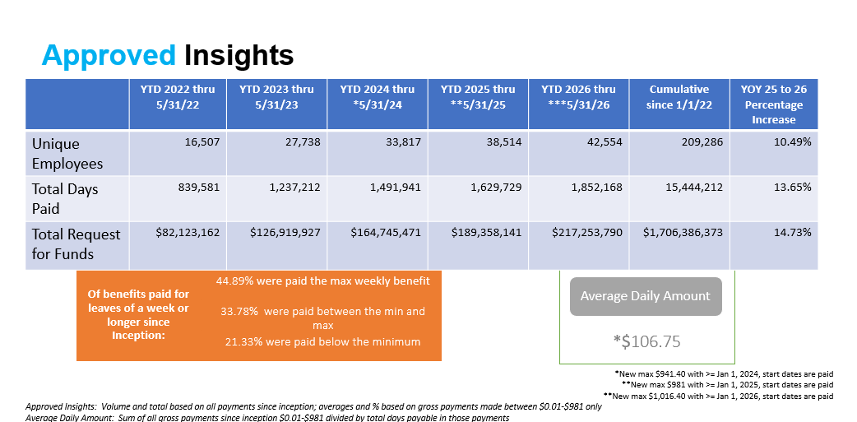
Approved Insights-Number of Unique Employees Paid, Total Days Paid and Total Program Payments Made.
Notes:
The number of Unique Employees paid by CTPL has risen to 209,286 and the Total amount the program has paid to Connecticut workers is now over 1.7 Billion Dollars.
2026 YTD total days paid increased by 13.65% compared to 2025 with a total of 15.4 million workdays paid. YOY YTD payments are up 14.73% thus far in 2026.
Average weekly payments over the last 26 weeks have risen to $9.92 Million per week. All payment metrics show significant growth from 24 to 25 and 25 to 26.

Slide 11
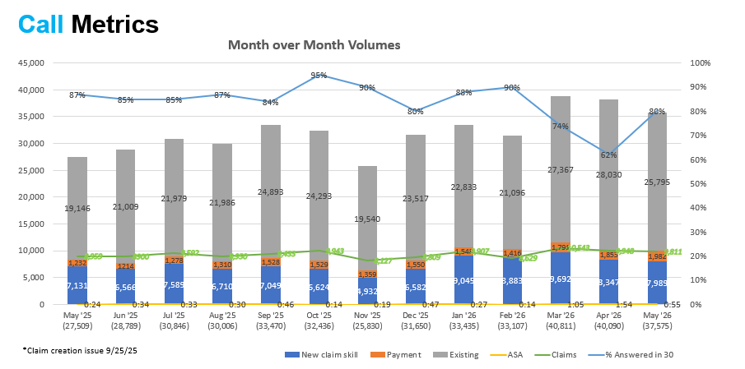
Call Center Metrics
Notes:
Call center call metrics show the average number of monthly calls into the call center over the last 12 months was 33,170 per month with 83% answered in 30 seconds or less. Total call volume for the YOY 12-month period was up by 37,070 calls or 10.27%, while call volume over the past three months are up by 36% on a YOY basis. YOY claims filed over the past three months have also increased by 14.62% which is driving the additional call volume. The 12-month average speed to answer a call has increased to 44 seconds as a result of increased call volume. Claimant call types received by type of customer service skill were 72% for Existing Claim Service, 23% for New Claims and 5% for Payment inquiries.

